Slide 1

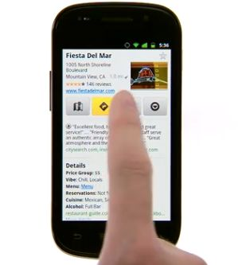
Web Mobile
Develop web applications
for mobile devices
Notes:
© SUPINFO International University - http://www.supinfo.com
SUPINFO vous permet de partager ce document
Vous êtes libre de :
Partager — reproduire, distribuer et communiquer ce document Remixer — modifier ce document
A condition de respecter les règles suivantes :
Indication obligatoire de la paternité — Vous devez obligatoirement préciser l’origine « SUPINFO » du document au début de celui-ci de la même manière qu’indiqué par SUPINFO International University – Notamment en laissant obligatoirement la première et la dernière page du document, mais pas d'une manière qui suggérerait que SUPINFO International University vous soutiennent ou approuvent votre utilisation du document, surtout si vous le modifiez. Dans ce dernier cas, il vous faudra obligatoirement supprimer le texte « SUPINFO Official Document » en tête de page et préciser notamment la page indiquant votre identité et les modifications principales apportées.
En dehors de ces dispositions, aucune autre modification de la première et de la dernière page du document n’est autorisée.
NOTE IMPORTANTE : Ce document est mis à disposition selon le contrat CC-BY-NC-SA Creative Commons disponible en ligne http://creativecommons.org/licenses ou par courrier postal à Creative Commons, 171 Second Street, Suite 300, San Francisco, California 94105, USA modifié en ce sens que la première et la dernière page du document ne peuvent être supprimées en cas de reproduction, distribution, communication ou modification. Vous pouvez donc reproduire, remixer, arranger et adapter ce document à des fins non commerciales tant que vous respectez les règles de paternité et que les nouveaux documents sont protégés selon des termes identiques. Les autorisations au-delà du champ de cette licence peuvent être obtenues à support@supinfo.com.
© SUPINFO International University – EDUCINVEST - Rue Ducale, 29 - 1000 Brussels Belgium . www.supinfo.com

Slide 2

Web Mobile
Course objectives
By completing this course, you will be able to:
Explain the evolution of the mobile devices
Explain the evolution of the different specifications
Develop mobile website following good practices
Develop jQuery Mobile applications
Enumerate other web mobile Frameworks

Slide 3


Web Mobile
Course topics
Course’s plan:
Introduction
Specification History
Good Practices
jQuery Mobile
Other Web Mobile Frameworks

Slide 4
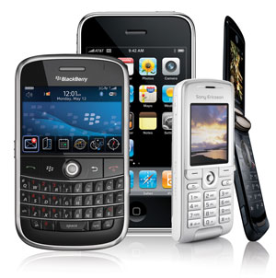
introduction
Web Mobile

Slide 5

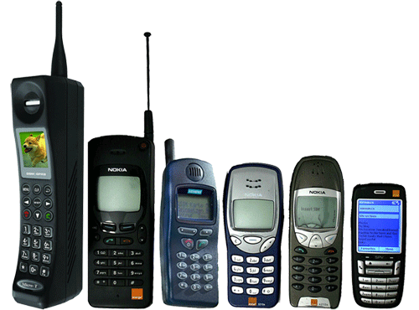
Introduction
Evolution of Mobile Phones

Slide 6
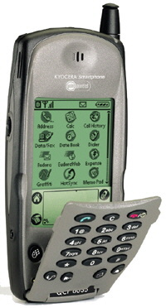
Introduction
Evolution of Smartphones
Kyocera 6035 -
The first smartphone in the American market.
Released in February 2001.
Specifications:
Operating System: Palm OS 3.5
CPU Clock: 16Mhz
RAM: 8MB
ROM: 2MB
Display Diagonal: 2,5”
Display Resolution: 160 x 160

Slide 7
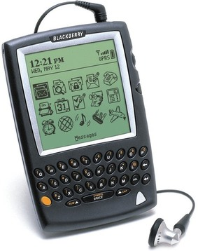
Introduction
Evolution of Smartphones
RIM BlackBerry 5810 -
The first commercialized RIM smartphone.
Released in March 2002.
Specifications:
Operating System: BlackBerry OS 3.6
CPU Clock: 40Mhz
RAM: 1MB
ROM: 8MB
Display Diagonal: 3”
Display Resolution: 160 x 160

Slide 8
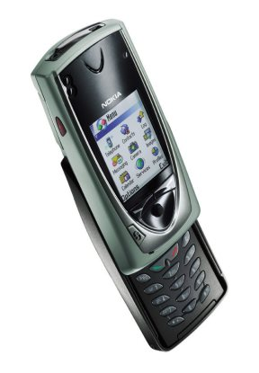
Introduction
Evolution of Smartphones
Nokia 7650 -
The first commercialized Nokia smartphone.
Released in second quarter of 2002.
Specifications:
Operating System: Symbian OS 6.1
CPU Clock: 104Mhz
RAM: 8MB
ROM: 16MB
Display Diagonal: 2.1”
Display Resolution: 176 x 208

Slide 9
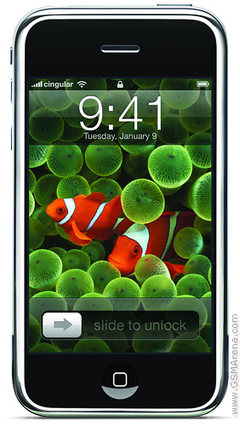
Introduction
Evolution of Smartphones
Apple iPhone -
The first commercialized Apple smartphone.
Released in September 2007.
Specifications:
Operating System: iPhone OS
CPU Clock: 412Mhz
RAM: 128MB
Storage: 4/8/16GB
Display Diagonal: 3.5”
Display Resolution: 320 x 480

Slide 10
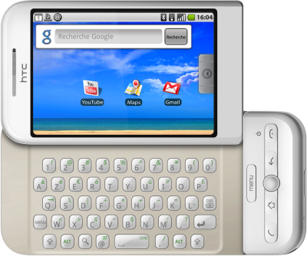
Introduction
Evolution of Smartphones
HTC Dream -
The first commercialized Android phone.
Released in October 2008.
Specifications:
Operating System: Android 1.5 (Cupcake)
CPU Clock: 528Mhz
RAM: 192MB
Storage: 256MB
Removable storage: Up to 16GB microSD
Display Diagonal: 3.2”
Display Resolution: 320 x 480

Slide 11
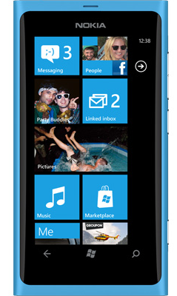
Introduction
Evolution of Smartphones
Nokia Lumia 800 -
The first Windows Phone 7 success (?)
and the reborn of Nokia.
Released in October 2011.
Specifications:
Operating System: Windows Phone 7
CPU Clock: 1,4Ghz
RAM: 512MB
Storage: 16GB
Display Diagonal: 3.7”
Display Resolution: 480 x 800

Slide 12
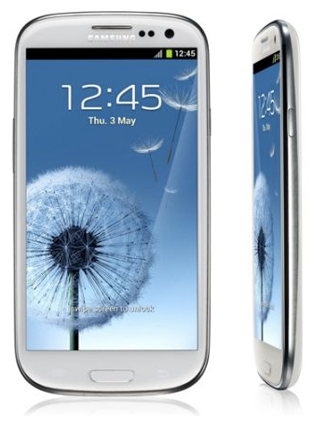
Introduction
Evolution of Smartphones
Samsung Galaxy S III -
A true concurrent for the iPhone.
Released in May 2012.
Specifications:
Operating System: Android 4.0.4
CPU Clock: Quad-core 1.4 GHz
RAM: 1GB
Storage: 16/32/64GB
Removable storage: Up to 64GB microSD
Display Diagonal: 4.8”
Display Resolution: 720 x 1280

Slide 13
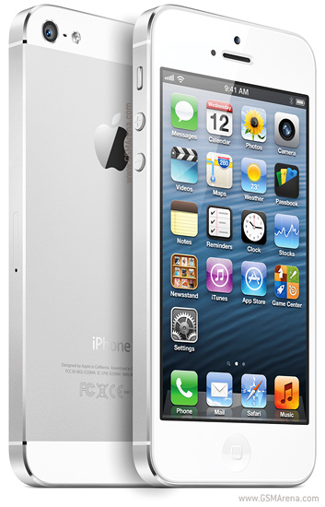
Introduction
Evolution of Smartphones
Apple iPhone 5 -
The last Apple smartphone.
Released in September 2012.
Specifications:
Operating System: iOS 6
CPU Clock: Dual-core 1.2 GHz
RAM: 1GB
Storage: 16/32/64GB
Display Diagonal: 4.0”
Display Resolution: 640 x 1136
Notes:
So much different specifications, so much different display resolution, one common point : The Web Browser !

Slide 14

Introduction
Evolution of Mobile Networks
 | Data rates
GPRS (2.5G) | ~ 50 Kbit/s
EDGE (2.75G) | ~ 64 Kbit/s
UMTS (3G) | 144 - 2048 Kbit/s
HSDPA (3.5G) | 3.6 - 7.2 Mbit/s
LTE (3.9G) | 40 - 80 Mbit/s

Slide 15
Introduction
Why websites for mobile devices ?
Mobile devices are more and more powerful
Hardware similar to some computers not so old…
Mobile network is faster and faster
Data rates similar to some ADSL connections

Slide 16
Introduction
Why websites for mobile devices ?
Mobile devices bring new useful technologies :
Smartphone is the most personal and mobile media tool
Reaches where other media cannot
Multi-touch
Geo-location
Camera
Accelerometer
NFC
…

Slide 17
Introduction
Why websites for mobile devices ?
The first billion Internet users was reached by the PC, the second will arrive by the mobile.
Google
Since Q4/2010, smartphones (mobile phone, 3G, keyboard, OS, e-mail...) outsell computers for the first time.
IDC Report

Slide 18
Introduction
Web or Native ?
Source of a lot of debate…
A native applications is often more efficient and can use native API
A web application can reach the computer and the mobile worlds regardless of the OS
You just need a browser !

Slide 19
Introduction
One engine to bring them all… (almost)
A lot of different mobile OS…
… but not a lot of different browser engines !
WebKit:
iOS, Android, Palm, Nokia, BlackBerry…
Opera Mobile (will soon be based on Webkit)
IE Mobile
…

Slide 20
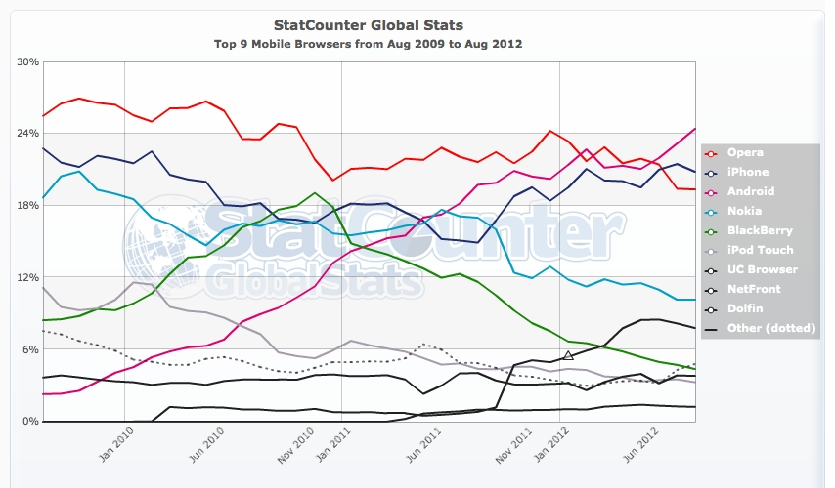

Slide 21


Questions ?

Slide 22


specifications History
Web Mobile

Slide 23
Specifications History
History
1997
WAP Forum
1998
Wireless Markup Language
2002
WAP 2.0
XHTML Mobile Profile
WAP Forum joins the Open Mobile Alliance

Slide 24
Specifications History
WAP Forum
The WAP Forum main aim:
Bring together the various wireless technologies in a standardized protocol
It was composed of famous actors:
Nokia, Ericsson, Microsoft, Motorola, …

Slide 25
Specifications History
WAP & WML
Wireless Application Protocol (WAP)
A technical standard for accessing information over a mobile wireless network
For WAP 1.x, the primary language to design application was:
Wireless Markup Language (WML)

Slide 26
Specifications History
WAP & WML
Example of WML page :
<?xml version="1.0"?>
<!DOCTYPE wml PUBLIC "-//WAPFORUM//DTD WML 1.1//EN"
"http://www.wapforum.org/DTD/wml_1.1.xml">
<wml>
<card id="main" title="First Card">
<p mode="wrap">This is a sample WML page.</p>
<a href="wtai://wp/mc;%2B19035551212">A link</a>
</card>
</wml>

Slide 27
Specifications History
WAP & XHTML
WAP 2.0 was released in 2002
End-to-end HTTP instead of custom protocol suite
WML replaced by a cut-down version of XHTML
XHTML Mobile Profile

Slide 28
Specifications History
WAP & XHTML
Example of XHTML MP page :
<?xml version="1.0" encoding="UTF-8"?>
<!DOCTYPE html PUBLIC "-//WAPFORUM//DTD XHTML Mobile 1.2//EN"
"http://www.wapforum.org/DTD/xhtml-mobile10.dtd">
<html xmlns="http://www.w3.org/1999/xhtml" xml:lang="en">
<head>
<title>Hello world</title>
</head>
<body>
<p>Hello <a href="http://example.org/">world</a>.</p>
</body>
</html>

Slide 29
Specifications History
History
2001
XHTML Basic 1.0
2004
Creation of the WHATWG
2007
The W3C adopts the WHATWG HTML5
2008
XHTML Basic 1.1
XHTML MP 1.2

Slide 30
Specifications History
XHTML Basic
XHTML Basic is a W3C specification
Subset of XHTML 1.1
Suitable for mobile phones, PDAs, pagers, and interactive televisions

Slide 31
Specifications History
XHTML MP or XHTML Basic ?
What is the difference between XHTML MP and XHTML Basic ?
XHTML MP was designed before the W3C finished the XHTML specification
In 2008, the two specifications became the same language

Slide 32
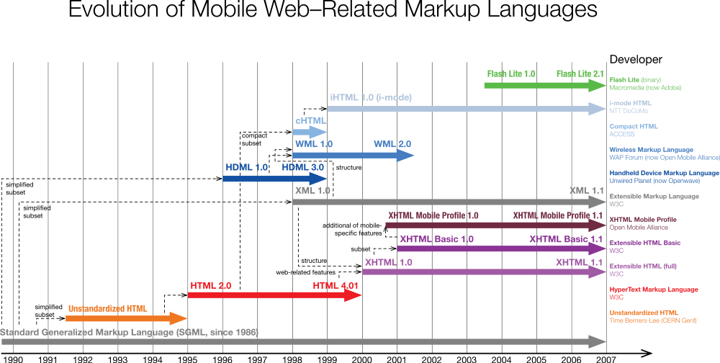

Slide 33
Specifications History
And HTML 5 ?
Remember what we said :
Many features of HTML5 have been built with the consideration of being able to run on low-powered devices such as smartphones and tablets
XHTML and its different sub-sets will be phased out and replaced with it

Slide 34
Questions ?

Slide 35

Good Practices
Web Mobile

Slide 36
Good Practices
Mobile Web & W3C
In July 2008, the W3C publish the Mobile Web Best Practices 1.0 basic guidelines
Usable Screen Width: 120 pixels, minimum
Markup Language: XHTML Basic 1.1
Maximum Total Page Weight: 20 KB
No JavaScript, no frames
…
Notes:
http://www.w3.org/TR/mobile-bp/

Slide 37
Good Practices
Mobile Web & W3C
This guideline is very interesting but 5-years-old
If you want to target only recent mobile devices, you can break some of those practices
Most of them support JavaScript and have a larger screen
Notes:
http://www.w3.org/TR/mobile-bp/

Slide 38
Good Practices
Mobile URL
What is the better URL for your mobile site ?
http://m.website.fr ?
http://website.mobi ?
http://website.fr/mobile ?
Or the same than for computers: http://website.fr ?

Slide 39
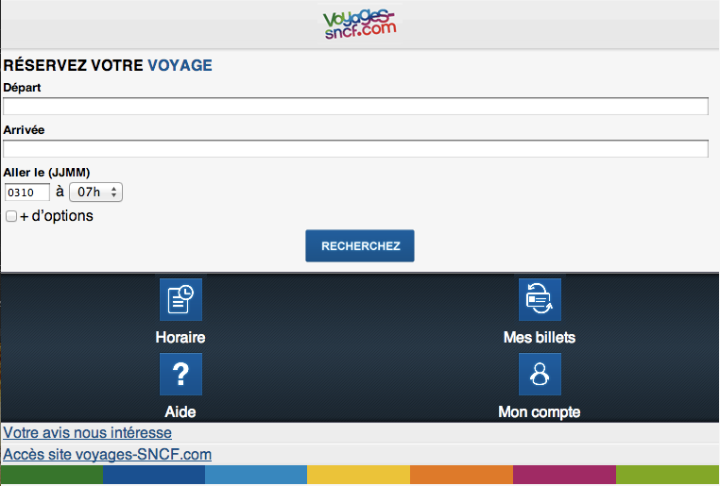
Good Practices
Mobile URL - Case study
Do you know http://voyages-sncf.mobi ?
A mobile version of http://voyages-sncf.com

Slide 40
Good Practices
Mobile Website URL - Case study
If a mobile user go to the desktop version
He’s not redirected to the mobile version
If a desktop user go to the mobile version
He’s not redirected to the desktop version

Slide 41
Good Practices
Mobile Website URL - Case study
How a user go to the Voyages SNCF website ?
With Search Engines !
If you Google “Voyages SNCF”
You can find the mobile website around page 3 !

Slide 42
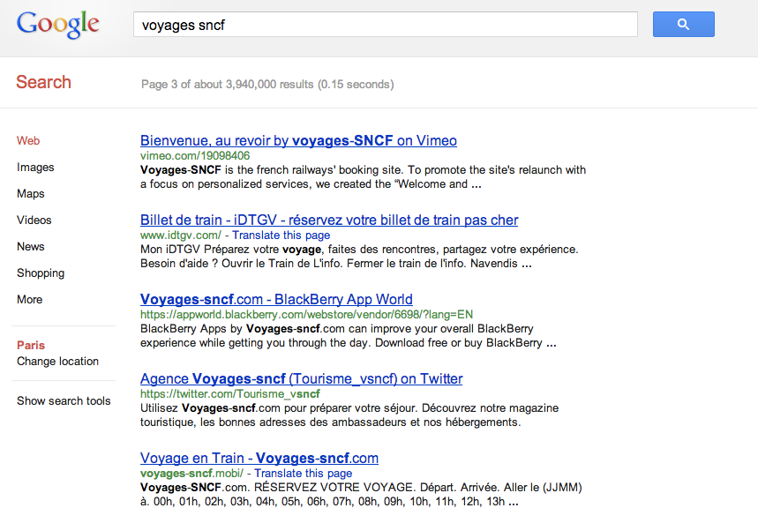
Good Practices
Mobile Website URL - Case study
Query
SERP number
Mobile version

Slide 43
Good Practices
Mobile URL
SEO is difficult for mobile websites
For Search Engines, the desktop and mobile versions are competitors
But you can now fix that with the following link element:
<link rel="canonical" href="http://mywebsite.com" />
Notes:
You can read the 1JWB course for more information.

Slide 44
Good Practices
Mobile URL
The Mobile Web Best Practices 1.0 advises to follow the One Web principle :
Ensure that content provided by accessing a URI yields a thematically coherent experience when accessed from different devices.

Slide 45
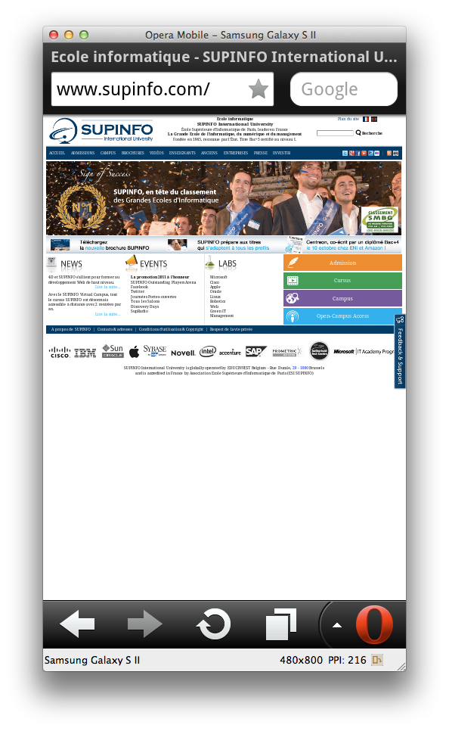
Good Practices
Meta viewport
The viewport is the phone’s browser area
Recent mobile browsers can render full pages inside it by scaling them
Users can then zoom-in on areas of interest and pan around on the page

Slide 46
Good Practices
Meta viewport
For a lot of sites, this way of page handling and interaction is sufficient
But it can be useful to control the size and scaling of the page
For mobile-optimized web app
The viewport meta tag was made for that !

Slide 47
Good Practices
Meta viewport
The viewport meta tag override the default viewport
<meta name="viewport" content="width=320, initial-scale=0.5">

Slide 48
Good Practices
Meta viewport - Specific width
You can define specific viewport width
Browser’s canvas will have the specified width
The result will be fit as neatly as possible
<meta name="viewport" content="width=320">

Slide 49
Good Practices
Meta viewport - Specific width
Example with a 320px viewport width:
If the screen area is 360px wide
The content will be scaled up by a factor of 1.125
If the screen area is 240px wide
The content will be smaller by a factor of 0.75

Slide 50
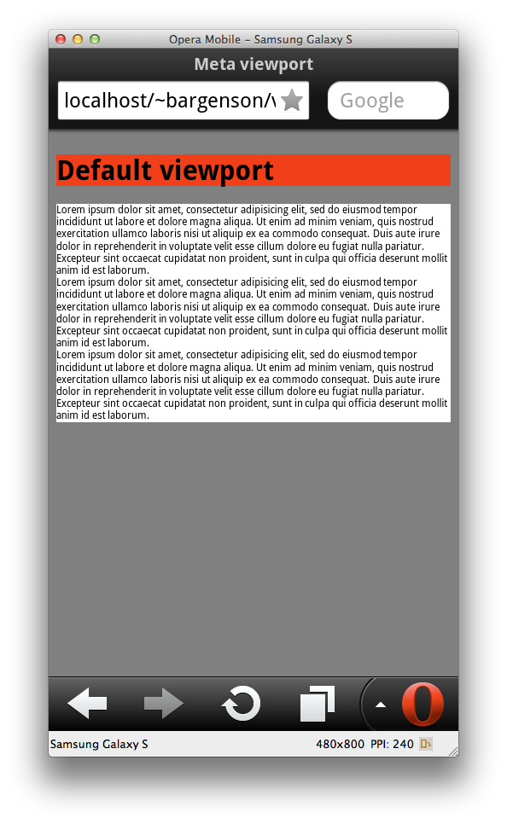
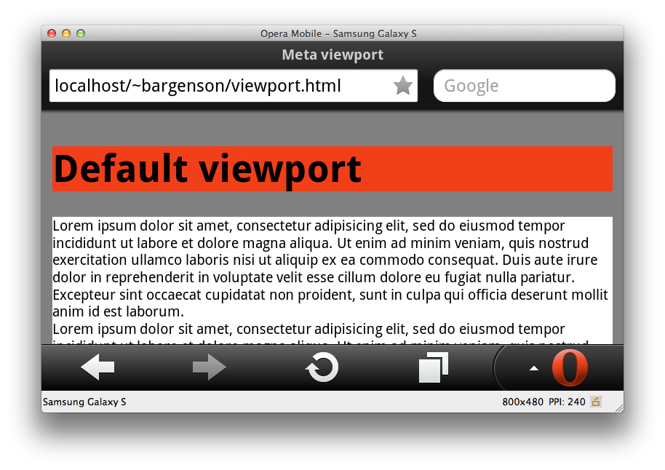
Good Practices
Meta viewport - Specific width

Slide 51
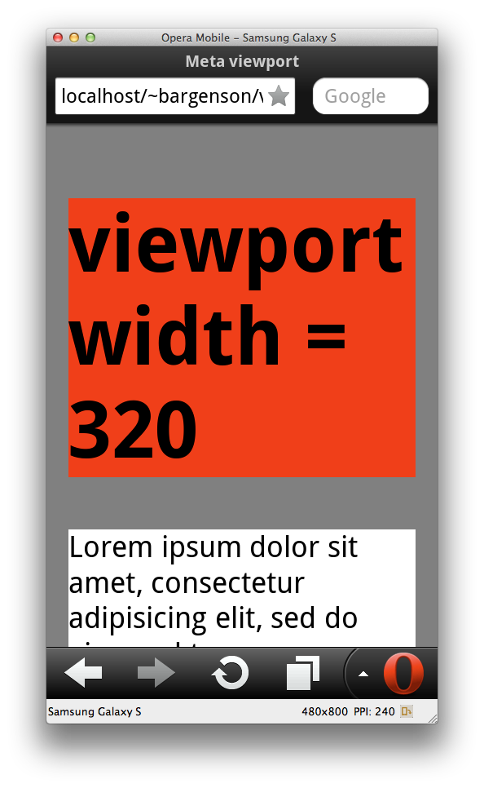
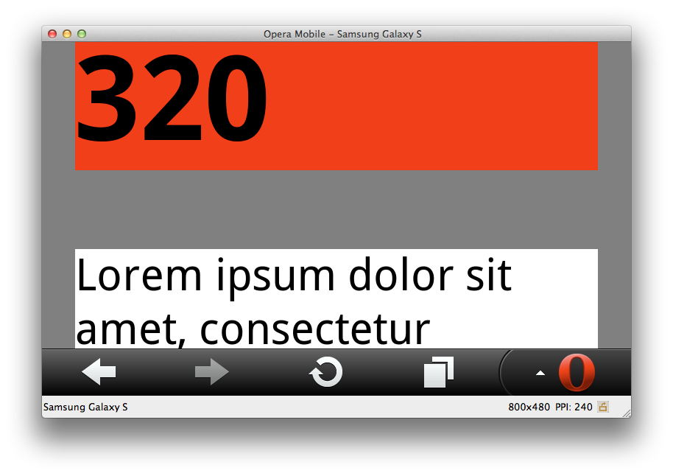
Good Practices
Meta viewport - Specific width

Slide 52
Good Practices
Meta viewport - Specific width
The recommended practice is to set the viewport width to be equal to the screen width
No scaling will occur
The same rendering than inside a desktop browser window of the same width
<meta name="viewport" content="width=device-width">

Slide 53
Good Practices
Other viewport properties
Some other viewport properties exist :
height
initial-scale
maximum-scale
minimum-scale
user-scalable

Slide 54
Good Practices
Other viewport properties
Examples :
<meta name="viewport" content="width=320, height=device-height">
<meta name="viewport"
content="width=320, maximum-scale=2, minimum-scale=0.5">
<meta name="viewport" content="width=320, initial-scale=2">
<meta name="viewport" content="width=320, user-scalable=no">

Slide 55
Good Practices
And CSS3 ?
We saw that we can use CSS3 media queries to define style rules in function of screen sizes
Some mobile browsers don’t use the device-width as default viewport width
Because of that, some rules may not work !
So, don’t forget the meta viewport

Slide 56
Good Practices
The three most important things
Always think to three things when you develop a mobile website :
Standards - Usability - Speed
Notes:
http://www.web-tambouille.fr/2011/09/18/optimiser-votre-site-web-sur-mobile-jug-summer-camp-2011-slides.html

Slide 57
Good Practices
Standards
For the markup language :
Use XHTML 1.1 (Basic or not) or HTML 5
Remember of the W3C Markup Validation Service
For CSS :
W3C CSS Validation Service

Slide 58
Good Practices
Standards
For JavaScript :
Use strict mode
Semicolons mandatory
++ and -- forbidden
…
You can use JSLint to check your code quality

Slide 59
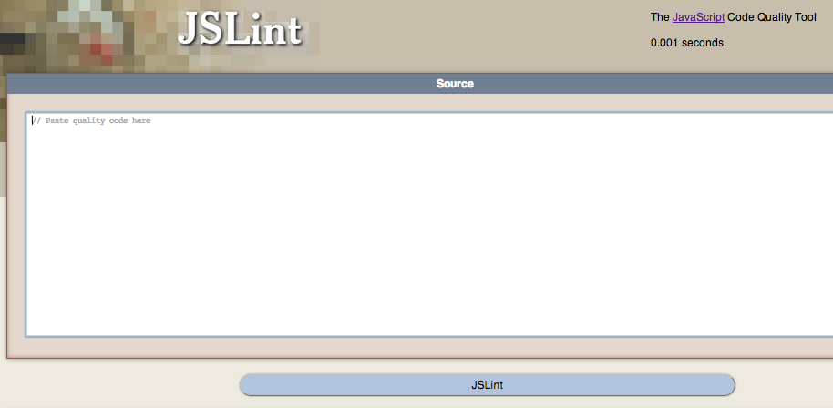
Good Practices
Standards

Slide 60
Good Practices
Usability
Mobile Website != Computer Website
Computer :
Wide screen in landscape position, mouse, keyboard, …
Mobile :
Small screen, can be in landscape or portrait position, virtual keyboard, …

Slide 61
Good Practices
Usability
To test your mobile website :
Opera Mobile Emulator
Screenfly (http://quirktools.com/screenfly/)
Adobe Edge Inspect
Android / WP7 emulator
…

Slide 62
Good Practices
Speed
Mobile screens are small and connection can be weak
Don’t try to display too much information on the same page !

Slide 63
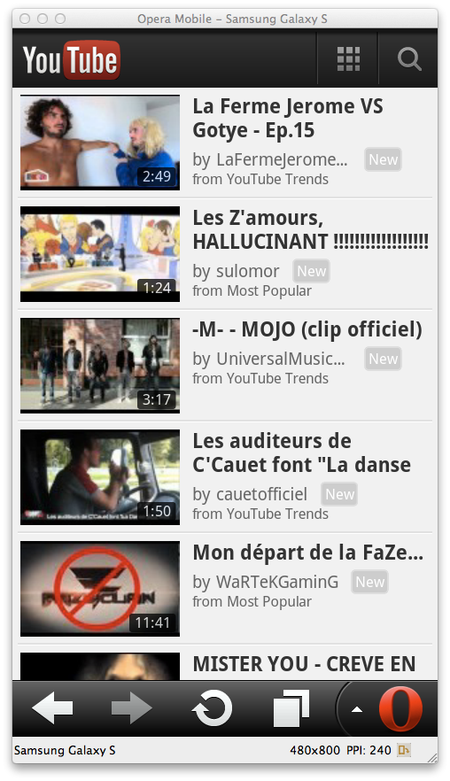
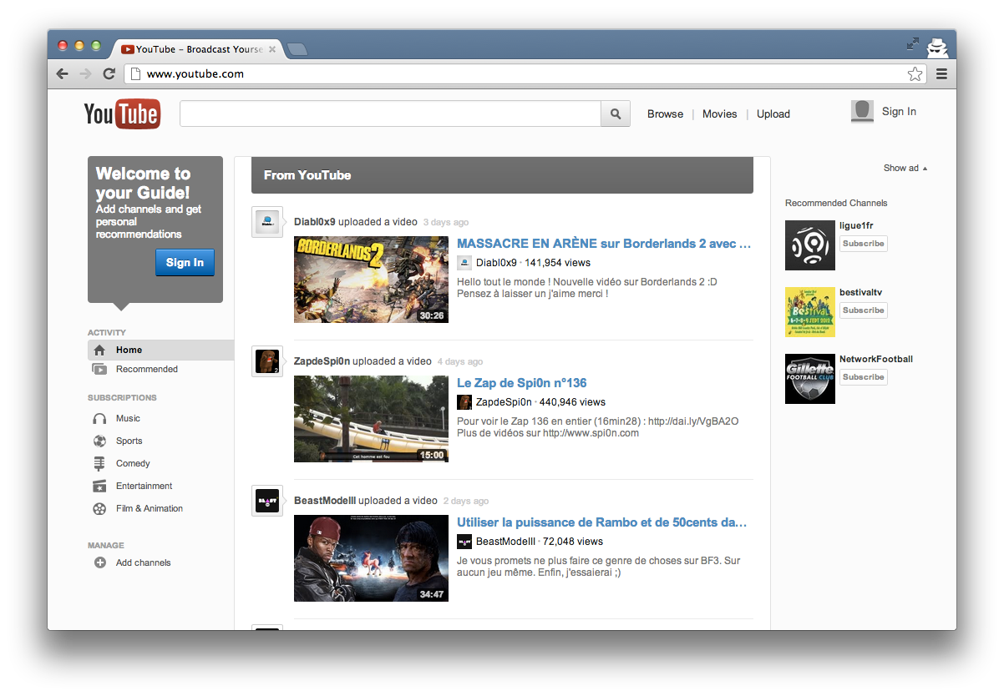
Good Practices
Speed
~423 KB transferred
~25 KB transferred

Slide 64
Good Practices
Speed

Slide 65
Good Practices
Speed
Notes:
1 HTML file + 2 JS file + 1 CSS file = 4 call
YouTube = ~37 requests
So, if you are in the Parisian subway with EDGE, how many time to load the page ? :-)

Slide 66
Good Practices
Speed
Avoid pages greater than 20KB
Minify your CSS and JavaScript
Use CSS Sprites
Minimize client requests
Concatenate your CSS and JS files

Slide 67
Good Practices
Speed
Use client-side validation to avoid server requests
Use Ajax with parsimony
Data connection use a lot of battery

Slide 68
Questions ?

Slide 69

Jquery mobile
Web Mobile

Slide 70
jQuery Mobile
Presentation
A unified user interface system that works seamlessly across all popular mobile device platforms, built on the rock-solid jQuery and jQuery UI foundation.
Notes:
http://jquerymobile.com/

Slide 71
jQuery Mobile
Presentation
Similar to jQuery UI but for mobile devices
Includes :
Ajax navigation system
Animated page transitions
A flexible theming system
Touch-friendly UI widgets
Pages, dialogs, toolbars, listviews, buttons, …
Notes:
http://jquerymobile.com/

Slide 72
jQuery Mobile
Presentation
jQuery Mobile is based on standards :
Semantic HTML
CSS
JavaScript improved by jQuery API
WAI-ARIA
Notes:
http://jquerymobile.com/

Slide 73
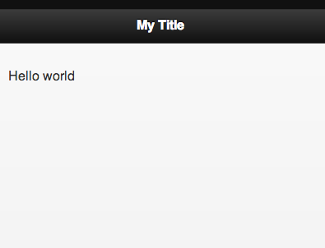
<!DOCTYPE html>
<html>
<head>
<title>My Page</title>
<meta name="viewport"
content="width=device-width, initial-scale=1">
<!--jQuery & jQuery Mobile JS and CSS files-->
</head>
<body>
<div data-role="page">
<div data-role="header">
<h1>My Title</h1>
</div>
<div data-role="content">
<p>Hello world</p>
</div>
</div>
</body>
</html>
Simple jQuery Mobile
Page Example
Notes:
http://jquerymobile.com/

Slide 74
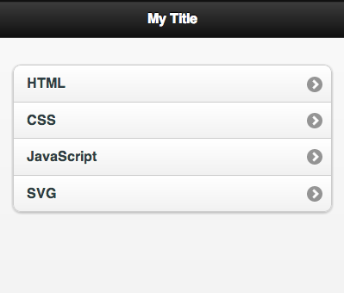
...
<body>
<div data-role="page">
<div data-role="header">
<h1>My Title</h1>
</div>
<div data-role="content">
<ul data-role="listview" data-inset="true">
<li><a href="#">HTML</a></li>
<li><a href="#">CSS</a></li>
<li><a href="#">JavaScript</a></li>
<li><a href="#">SVG</a></li>
</ul>
</div>
</div>
</body>
...
Simple jQuery Mobile
Listview Example
Notes:
http://jquerymobile.com/

Slide 75
jQuery Mobile
Presentation
jQuery Mobile contains a full set of form widgets
Automatically enhanced with a touch-friendly style
Notes:
http://jquerymobile.com/

Slide 76
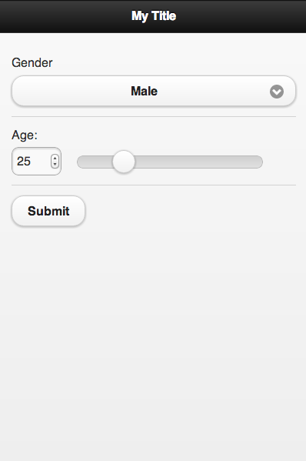
<form>
<div data-role="fieldcontain">
<label for="gender">Gender</label>
<select id="gender" name="gender">
<option value="MALE">Male</option>
<option value="FEMALE">Female</option>
</select>
</div>
<div data-role="fieldcontain">
<label for="age">Age:</label>
<input type="range" id="age"
name="age" min="0" max="100"/>
</div>
<div data-role="fieldcontain">
<input type="submit"
value="Submit" />
</div>
</form>
Simple jQuery Mobile
Form Example
Notes:
http://jquerymobile.com/

Slide 77
jQuery Mobile
Page concept
A page is define by the content of an element with the page data-role
Inside it, any valid HTML markup can be used
But typical pages have children with the following data-roles :
header
content
footer
Notes:
http://jquerymobile.com/

Slide 78
jQuery Mobile
Page concept
A single HTML document can contain multiple pages
Each page block needs a unique id that will be used to link internally between pages
Notes:
http://jquerymobile.com/

Slide 79
<body>
<div id="page1" data-role="page">
<div data-role="header">
<h1>Page 1</h1>
</div>
<div data-role="content">
<a href="#page2">Go to page 2</a>
</div>
</div>
<div id="page2" data-role="page">
<div data-role="header">
<h1>Page 2</h1>
</div>
<div data-role="content">
<a href="#page1">Go to page 1</a>
</div>
</div>
</body>
Multi-page Document
Notes:
http://jquerymobile.com/

Slide 80
jQuery Mobile
Navigation
jQuery Mobile includes a navigation system to :
Load linked pages into the DOM via AJAX
Enhance the new content
Display pages with a rich set of animated page transitions
All links and forms are automatically transforms to use this navigation system
Notes:
http://jquerymobile.com/

Slide 81
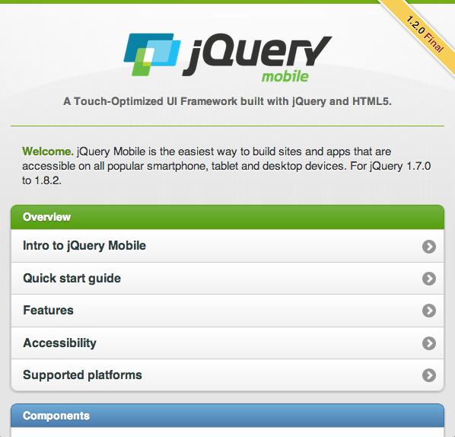
jQuery Mobile
Navigation
For more information about jQuery Mobile :
http://jquerymobile.com/demos/
Notes:
http://jquerymobile.com/

Slide 82
jQuery Mobile
Drawback
jQuery Mobile is heavy…
jQuery Core (minified): ~33KB
jQuery Mobile (minified): ~33.5KB
jQuery Mobile CSS (minified): ~11KB
Not optimized for mobile devices with low performances and low connection speed
Notes:
http://jquerymobile.com/

Slide 83
Questions ?

Slide 84



other Web mobile frameworks
Web Mobile
…

Slide 85
Web Mobile Frameworks
Zepto.js
Zepto is a minimalist jQuery-compatible API
Downloads and executes fast
~5-10 KB modular library
Less than a quarter the size of jQuery
Don’t attempt to fix non-modern browsers
No support for Internet Explorer

Slide 86
$('div') //=> all DIV elements on the page
$('#foo') //=> element with ID "foo"
// create element:
$("<p>Hello</p>") //=> the new P element
// create element with attributes:
$("<p />", { text:"Hello", css: {color:'darkblue'}})
//=> <p style="color:darkblue">Hello</p>
// execute callback when the page is ready:
Zepto(function($){
alert('Ready to Zepto!')
})
Zepto.js Example

Slide 87

Web Mobile Frameworks
Sencha Touch
A User Interface JavaScript library
As jQuery Mobile
Built upon the MVC pattern
Support only browsers based on Webkit
Can be slow with some Android devices
The SDK includes a native packager for Android and iOS

Slide 88
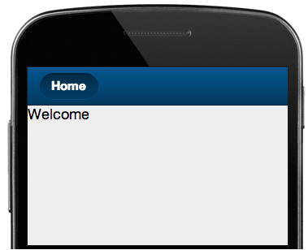
Ext.application({
name: 'Sencha',
launch: function() {
Ext.create("Ext.tab.Panel", {
fullscreen: true,
items: [
{
title: 'Home',
iconCls: 'home',
html: 'Welcome'
}
]
});
}
});
Sencha Touch
Application Example

Slide 89





Web Mobile Frameworks
Other Frameworks…
…

Slide 90
Questions ?

Slide 91


